Slide 1
Annex 5
Country Report
Sep. 2017 ECIT
Notes:
Annex 4

Slide 2
Part 1 Brief Introduction of China
Part 2 Big Data in China
Part 3 Other Sharing of Big Data

Slide 3
Part 1 Brief Introduction of China

Slide 4
1-1 Population
In 2016, the total population of mainland China is about 1.3 billion 82.7 million (including 31 provinces, autonomous regions, municipalities and the Chinese People's Liberation Army servicemen, excluding Hong Kong, Macao and Taiwan and overseas Chinese). An increase of 8.09 million over 2015.
In 2016, the newly-born population is 17.86 million and the death population is 9.77 million people.
Population

Slide 6
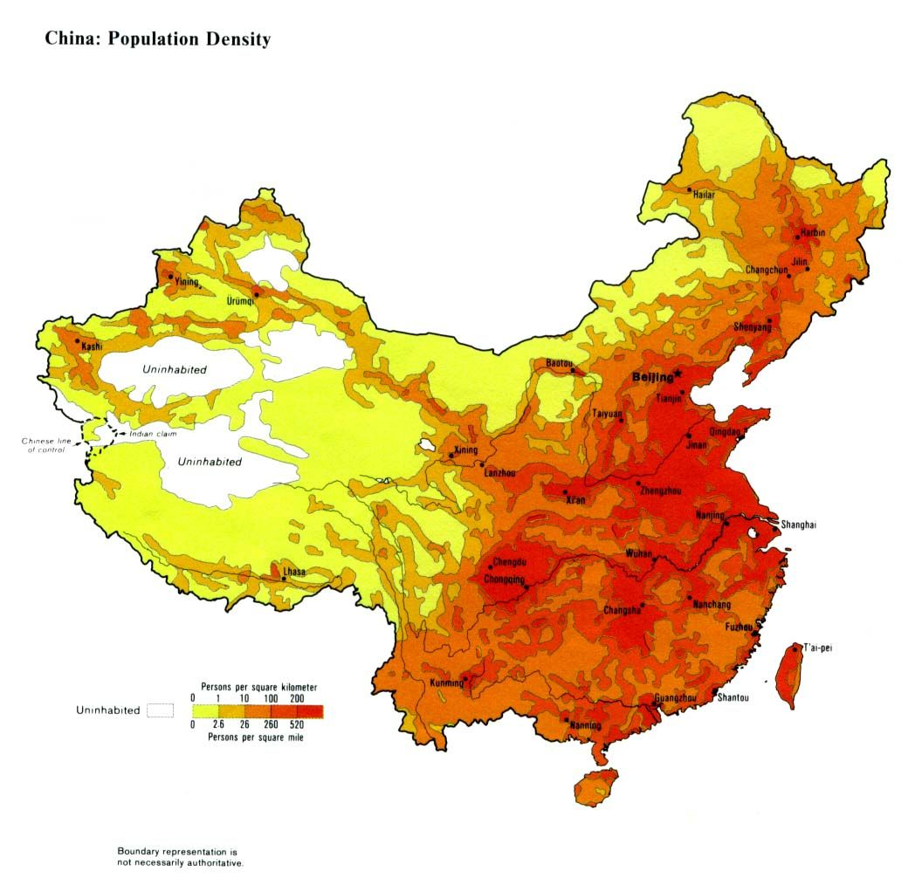
1-2 Population density
China is the most populous country in the world.
By the end of 2013, there were 1360.72 million people living in mainland China, accounting for 19% of the world‘s total population.
China has an average population density of 143 people per square kilometer, about 3.3 times of the world population density.

Slide 7
1-3 Population Distribution
East
Central
West
The eastern coastal areas are densely populated with more than 400 persons per square kilometer.
The central region is more than 200 kilometers per square kilometer.
The western plateau region is scarce and less than 10 per square kilometer.
China's population distribution is very uneven.

Slide 8
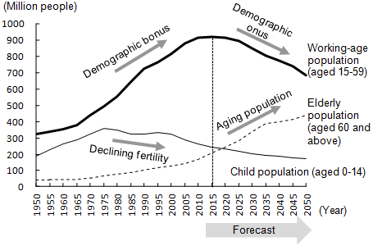
1-3 Population Distribution
Age composition
The labor age population of 16 to 60 years old(excluding 60 years old) is about 970.47 million people, accounting for 65.62% of the total population.
60 years old and above is about 230.86 million, accounting for 16.69% of the total population.
65 years old and above is about 150 million people, accounting for 10.85% of the total population.

Slide 9
1-3 Population Distribution
Urban and rural structure
The urban resident population is 823.45 million, compared with the end of 2015 increased by 21.82 million people.
The rural resident population is 587.83 million, decreased by 13.73 million people.
The proportion of urban population to total population (urbanization rate) was 57.35%.
The floating population of the whole country is 245 million, compared with the end of previous year there has a decrease of 1.71 million.

Slide 10
1-4 Land area
China‘s land area is 9.6 million square kilometers, accounting for about 1/15 of the world’s total land area.
Slightly equivalent to the total area of the European countries except the Soviet Union, next to Russia (1707.5 million square kilometers) and Canada (9,971,000 Square kilometers), ranking 3rd in the world.

Slide 11
1-5 Land features
1.The absolute quantity is large,
but the per capita occupancy is small
2.The types are complex and diverse, the proportion of cultivated land is small
3.The utilization situation is complicated, the regional difference of productivity is obvious
4.The regional distribution is uneven, the protection and development problems are prominent
There are four basic features of land resources in China

Slide 12
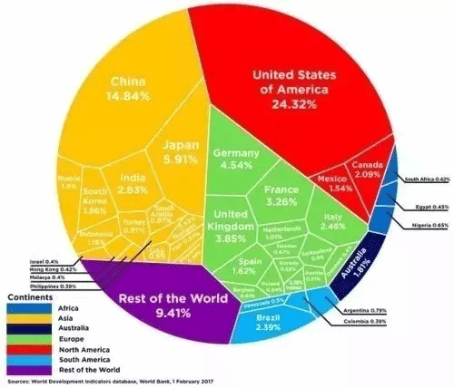
1-6 GDP
In 2016, the global GDP (gross domestic product) totaled $74 trillion.
Among them, the United States ranked first in the proportion of 24.32% and China ranked second, accounting for 14.84% of the total. 3rd and 4th were Japan and Germany, accounting for 5.91% and 4.54% respectively.

Slide 13
1-7 Communication Equipment Manufacturers
China’s telecommunications network construction started late, but develops quickly with the rapidly development of the Internet and the promoting of communications industry policy.
Huawei Technologies Co Ltd and ZTE Corp, China’s top two telecommunications equipment makers, are stealing a march on rivals both in traditional network gear and, increasingly, high-end phones.

Slide 14
Part 2 Big Data in China

Slide 15
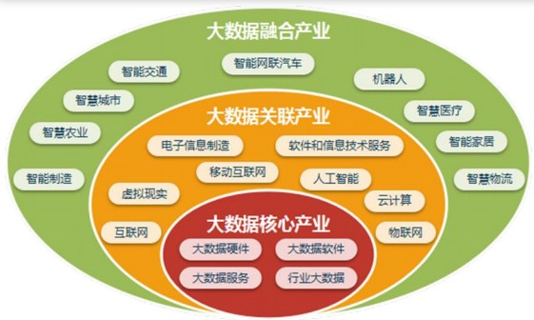
2-1 Understanding of Big Data
In terms of conceptual definition, the big data industry refers to economic activities mainly based on data production, collection, storage, processing, analysis and service, including data resources construction, software and hardware products development, sales and leasing activities, and related information technology services.
c
Understand from three industrial levels:
The core industries of big data | Software, hardware, services, etc. used specifically for processing cycles of big data.
The related industries of big data | In the process of big data operation, the industries provide its infrastructure, processing tools and related technologies.
The fusion industries of big data | The new business pattern and upgrade mode generated by the integration of big data and other industries

Slide 16
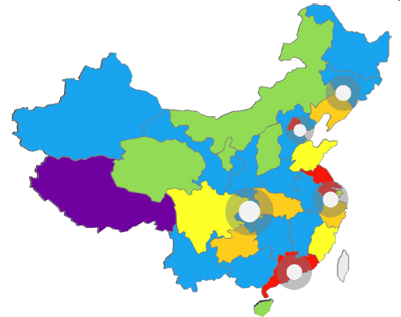
2-2 Present status of Big Data
The development pattern of regional agglomeration gradually formed
National comprehensive pilot areas for big data lead industrial development: the development trend of big data industries' agglomeration is obvious in the area of Yangtze River Delta ,Pearl River Delta ,midwest and northeast.
Beijing-Tianjin-Hebei
The development level of Beijing ranks first in the whole country
Yangtze River Delta
The overall level of development is high
Pearl River Delta
The development level of Guangdong's big data is next only to Beijing
Western Region
Sichuan, Guizhou and Hubei are leading provinces
Northeast
The role of radiation and driving in Liaoning is becoming increasingly evident

Slide 17
2-2 Present status of Big Data
Big data development levels of key industries vary significantly
Big data development levels of key industries vary significantly, Financial and government affairs lead the rapid development of big data industries .
The development's level of big data in various industries is from high to low:
1 | Financial | 6 | Medical treatment
2 | Government affairs | 7 | Education
3 | Traffic | 8 | Tourism
4 | Telecommunication | 9 | Industry
5 | Business | 10 | Agriculture
The basic environment is optimized.
There is little difference in industry applications.
Data collection has a gap.

Slide 18
2-2 Present status of Big Data
The strength of enterprise presents "Pyramid" shape
c
c
c
1
2
3
From the perspective of technology research and development, Chinese big data enterprises present a pattern of "corporate champion leading and small and medium-sized enterprises as the main enterprises".
From the market point of view, big data companies in China showed a distribution pattern that the main part is smooth and a small amount is outstanding , and the overall industry showed a steady development trend.
According to the application of large data technology, China focused on six major industrial sectors of data collection, data storage, data preprocessing, data analysis, data visualization, data flow .

Slide 19
2-3 Developing focus and strategies
Summary of work in 2016 and outlook for 2017
Industrial scale
Industrial agglomeration
Technological innovation
Industrial
big data
Big data of
Government affairs
Data flow
and security
2016
8 big data comprehensive experimental zones
technological integration and innovation has made important progress.
support intelligent manufacturing and industrial transformation and upgrading
promote the development of
big data security innovation
market size 310 billion yuan
provides basic data resources
2017
the scale is expected to reach 410 billion yuan
industrial agglomeration areas promote the formation of local characteristics
cloud computing, artificial intelligence and other new technical areas will be more closely linked
Establish industrial big data center and implement the demonstration project of industrial big data application
improve the administrative efficiency for government and optimize the means for social governance
increase investment in data security technology, products and services, and promote bilateral, regional and cross-border data flow cooperation

Slide 20
4 Experience sharing
Grasp the trend, seize the opportunity and accelerate the development of big data in Shanghai, mainly included the following points:
1
Stimulate market vitality, build innovative ecology of big data industry
2
Deepen the application of social governance, boost the construction of Shanghai international metropolis
3
Promote the opening, circulation and sharing of data resources

Slide 21
Part 3 Other Sharing of Big Data

Slide 22
5 Other sharing
Hold SODA contest, strengthen open source sharing and collaborative innovation
Shanghai has held an open data innovation application contest (SODA) for three consecutive years. Some excellent teams and works have been financed by investment institutions or cooperated with industry-scale enterprises. That will form the closed-loop of open data, innovative applications and hatching with becoming a business card of innovative demonstration for big data in Shanghai.

Slide 23
Thank You

