Slide 1
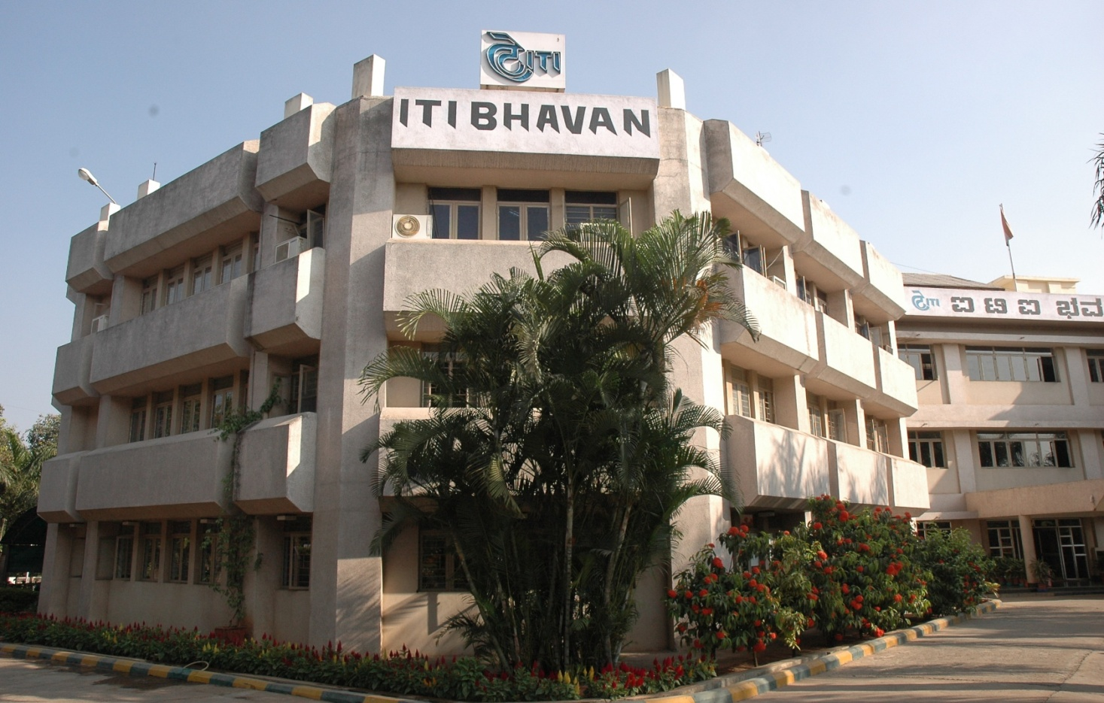
ITI LIMITED
Training And Development

Slide 2
ITI LIMITED
Established in 1948, First Public Sector Undertaking of India
Contributed 70% of landline network for the Nation
Total telecom solution provider for Civil and Defence networks
Rated as No.1 Telecom Turnkey Solution Provider in India
In mobile technology, commissioned two prestigious networks – GSM and CDMA for BSNL and MTNL
Designed and Commissioned most important, strategic and secure Pan India Defence Network – ASCON project for Indian Army
International project execution experience (CDMA network in Afghanistan)
6 Mfg Plants; 1 R&D; 1 NSU ; Mktg – 8 RO & 27 ARO
Manpower Strength : 6529 Employees (as on 1.11.14)

Slide 3
ITI- TRAINING POLICY
  To create an atmosphere of technological and managerial excellence through planned value addition to our employees’ career through HRD intervention.
  Employees to gain effectiveness in their assignment through a systematic training intervention for development of appropriate knowledge, skill and attitude
  To update knowledge to avoid obsolescence and enhance professional creativity
  to enhance the quality of life of individuals and also make them strong leaders

Slide 4
The Strategy
  Proper identification of training needs (TNA) through GAP Analysis
  Augmentation of knowledge, skill, attitude through a careful and planned Training & Development initiatives
  Designing and customising the training programmes

Slide 5
TRAINING FACILITIES
SIX full-fledged HR - Employee Development centers available with Audio-visual aids at various Units / Plants of ITI Ltd., viz Bangalore(2), Naini, Rae Berali, Mankapur and Palakkad for carrying out the training & development activities

Slide 6
HRD Initiatives
Skill Gap Analysis
Training & Development Programmes
Multi-skilling - On the Job Training (OJT)
Mentoring
Apprentice Trg.
Vocational Training
CSR- Project / In-Plant trainees

Slide 7
Skill Gap Analysis
HRD initiatives
Skill Gap Analysis :–
  An OD (Org. Development) intervention carried out during 2010-11
  Survey carried, covering around 10500 employees
  To assess their existing level of Skills & Skill Gaps.
Objective:
to overcome shortages of skilled resource
  to identify & document skills - Required Vs Existing.
  to identify critical / non critical skills for carry out role effectively.
  to assess existing skill levels and skill gaps
  to develop strategies to mitigate skill gaps
  to design & develop skill development training programs, OJT, job rotation, transfer of knowledge etc.,

Slide 8
Learning - Training & Development
HRD initiatives
Traning Programmes are conducted at the units of ITI- Bangalore, Raebareli, Mankapur, Naini & Palakkad.
State of the art technology and need based training imparted to Executives, Non-Executives and Trainees – Diploma Holders, Engineering Graduates
Effective Training in different areas of domain of technology/projects are imparted viz. Mobile technology (GSM,CDMA,CorDECT), MLLN, CSN, E10B, GPON, NGN, STP, MW transmission, SDH Product etc.,
Training programmes conducted by efficient & expert resource persons
Both In-House Training and External Training
Cont…

Slide 9
Training & Development- Stats
HRD initiatives
Year | 2013-2014 | 2012-2013 | 2011- 2012 | 2010- 2011 | 2009-2010
Total Manpower | 8516 | 9512 | 10616 | 11737 | 12556
No of Training Programmes | 121 | 161 | 133 | 131 | 109
Training Mandays Achieved | 3437 | 6100 | 3733 | 4575 | 4128
Employees Trained | 3029 | 4530 | 3078 | 3366 | 2902
% Employees Trained | 36% | 48% | 29% | 29% | 23%

Slide 10
MULTI SKILLING -OJT
HRD initiatives
Multi –Skilling through OJT: Introduced in 2003-04
  to neutralize peak load efficiency
  to meet delivery schedules
  easy mobility
  to fill the skill drain occurred due to VRS
Implementation : Carried out in all the Production Plants
Process : Planned schedule, modules & assessment of OJT trainees
Areas : SMT, CNC m/c operation, PCB, Assembly, M/c Shop, Inj Moulding, I&C- WLL CorDECT, CDMA, GSM etc.,
No. Trained : More than 5000 Non executives so far trained in multi skilling

Slide 11
Mentoring
HRD initiatives
Mentees posted under experienced mentor, who nurture them for specific period of time.
Mentoring scheme launched in 2012-13
30 mentors and 50 mentees are identified
Objective :
To continue Skill Development and Capacity Building
New Skills acquired through Coaching
To transfer of knowledge (ToT)
Smooth Succession Plan

Slide 12
Apprentices Training
HRD initiatives
Apprentice :
Training is imparted as per the Apprentice Act 1961. So far very large numbers of ITI certificate Holders have been trained.
Every year around 500 Apprentices are trained
Diploma & Graduate Engineering students:
Company imparts training to fresh Diploma and Graduate Engineers in different disciplines. Both theory and Practical's skills were developed.
Around 250 students are trained at various units of ITI every year.

Slide 13
Vocational Training
HRD initiatives
Skill Development & Capacity building initiatives :
Skill Development training in Mobile Technology (CDMA) for Diploma holders conducted by Bangalore Plant in association with of State Tech Boards for 6 weeks - 3 months was conducted in various states viz.
Kar,TN, AP,Kerala, MP, Punjab, HP, Raj, Guj, Uttararchal etc.,
  More than 150 Dipl student’s trained and their skills enhanced
  More than 250 Diploma & Graduate Engineering‘s skills were developed in WLL CDMA- both theory and practical.
  Students’ employability increased and many got employment after their training
Palakkad unit of ITI has started Training Programme in PCB manufacturing process covering Telecom for Plus 2 & under graduates students under the Additional Skill Acquisition Programme (ASAP) Govt of Kerala and Electronic Sector Skills Council of India(ESSCI)

Slide 14
CSR – Training
HRD initiatives
International Training Programs : Imparted training to -
  Engineers of Afghanistan Telecom
  Telecommunication consultants of India Ltd (TCIL) on CDOT technology.
  Engineers of NTPC in telecommunication area
Engineers of Sri Lanka, Nepal, Bangladesh etc., in switching technology.
Finishing Schools for Engineering graduates :
  More than 1000 students got benefit.
Project Trainees – In-plant, Project etc.,
  Every year many students undergo training & get benefit
  More than1500 students are being trained at various units of ITI every year.
  Around 9000 students got benefit during last 5 years

Slide 15
TRAINING – Skill Development:
iti - tssc/ asap/ essci
ITI Ltd signed MoU on 6th Mar 2014 with Telecom Sector Skill Council to promote and develop telecom skills and capacity building in telecommunication sector.
ITI got Training Provider(TP) certificate from TSSC on 7-4- 2014
ITI has planned for TSSC training in various modules in its Plants for around 200 Personnel during 2014-15.
Launched TSSC Training programme in August 2014, at Bangalore in PCB Manufacturing Module- 30 trained
At Palakkad 90 have been trained through ASAP / ESSCI .
Other Units also will start TSSC Training Programmes very shortly –
  Naini Plant : Solar Panel module
  Rae Bareli Plant : DWDM module
  Srinagar Plant : ESDM Module

Slide 16
ITI’s ROAD MAP skill development through training
To Develop Skills through training in :
Telecom Products
Providing Total Solutions covering whole spectrum–Switching, Transmission, Access & Subscriber Premises equipment
Information & Communication Technology
Network Management System(NMS)
Encryption

Slide 17
Thank
You

