Slide 1
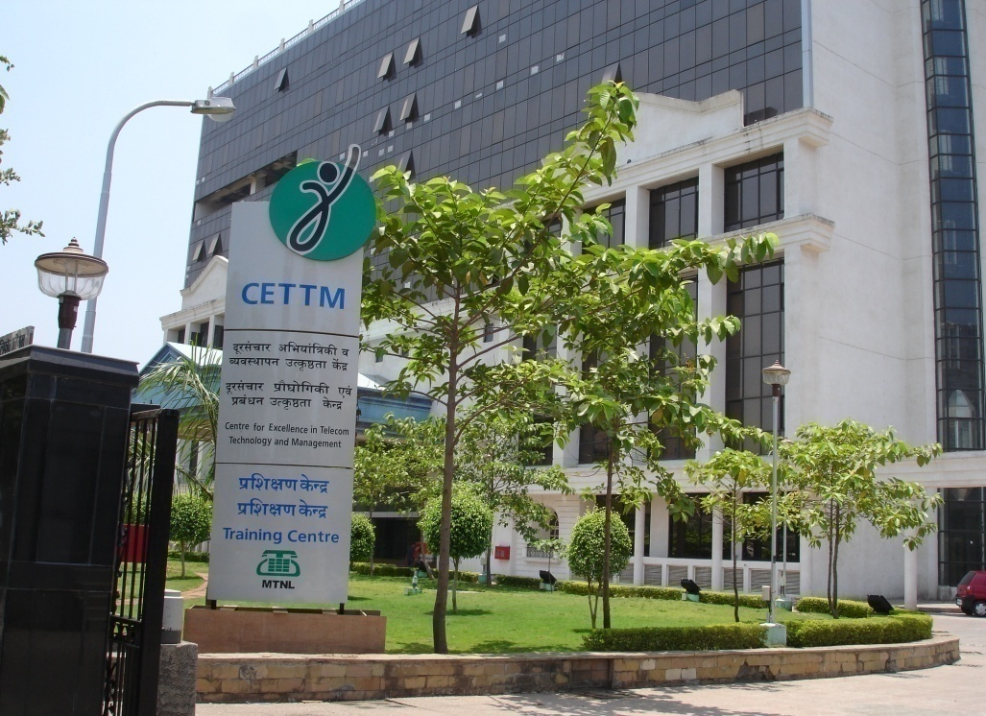
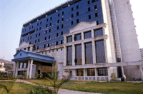
CETTM
Centre for Excellence in
Telecom Technology & Management
an ISO 9001:2008 Certified

Slide 2
CETTM…In Pursuit of Excellence
CETTM VISION
To become the most preferred training institution in advanced telecom technology and management in Afro-Asian region.

Slide 3
CETTM….Offerings
In-service Training Programs
Training Programs for Corporate.
Telecom Training to foreign Delegates (ITEC- SCAAP)
Training programs for Engg. Students Vacation Batches
Projects for M.B.A & Engg. Students and Industrial Training for Engg./Diploma students
Infrastructure Leasing to Corporate

Slide 4
CETTM Infrastructure
Lecture Halls
17 Fully air-conditioned Lecture Halls with 30 executive seating
Equipped with teaching aids like Projector, white board, pull down screen
Ultra modern public Address system with Podium Mike / collar mike
Desktop PC for the trainer

Slide 5
Faculties
ITTM Delhi
Total - 14
B. Tech. -1
MBA- 4
MSc/BSc - 5
CETTM Mumbai
Total - 29
B. Tech. -11
MBA-14
BSc./MSc - 4

Slide 6
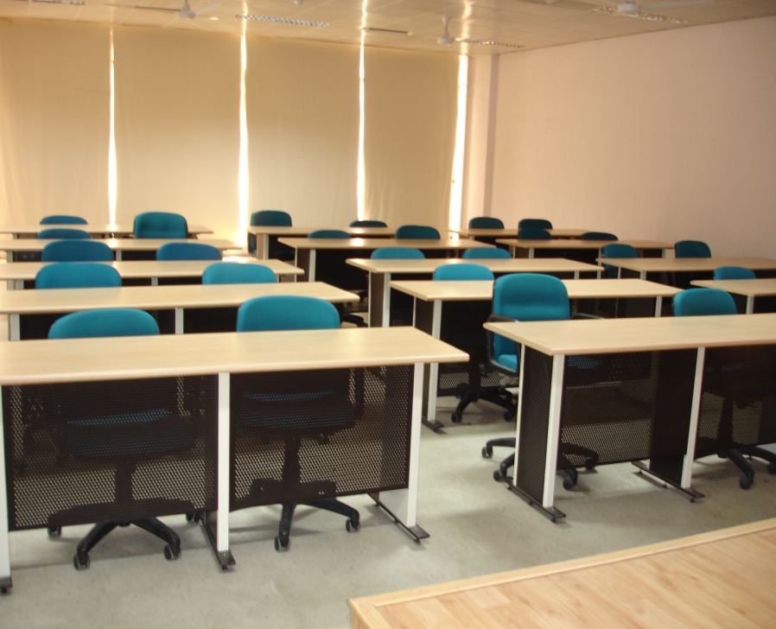
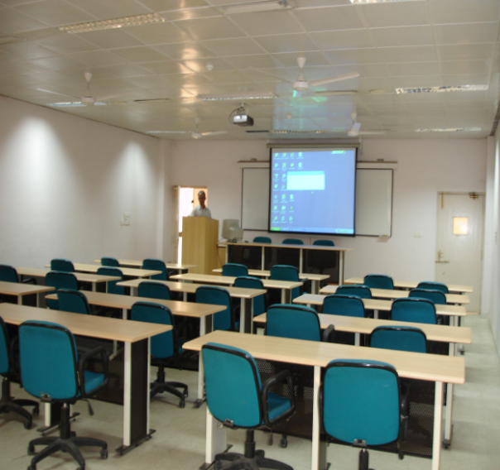
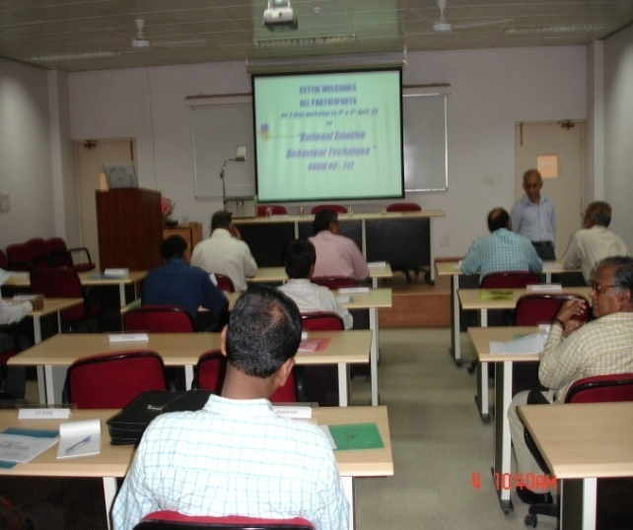
The Lecture Halls
17 Class rooms

Slide 7
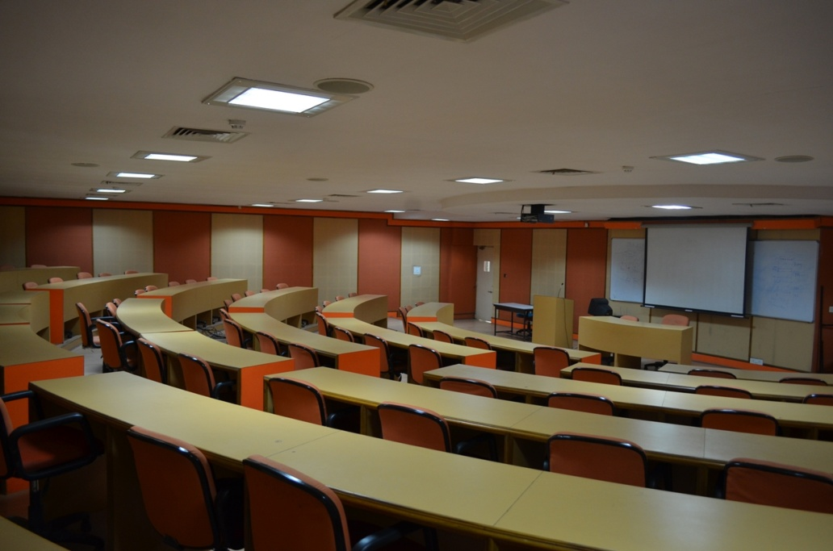
CETTM Infrastructure
Semi-Circular Seminar Hall
Seating Capacity of 72
Equipped with Tower AC facility
Full audio visual features

Slide 8
CETTM Infrastructure
Conference Hall
Acoustically designed Ultra modern audio visual facilities
Seating capacity- 60 persons
4 - way Video conferencing ,
One large central screen and two side LCD screens
Ideal for board meetings and business meets

Slide 9
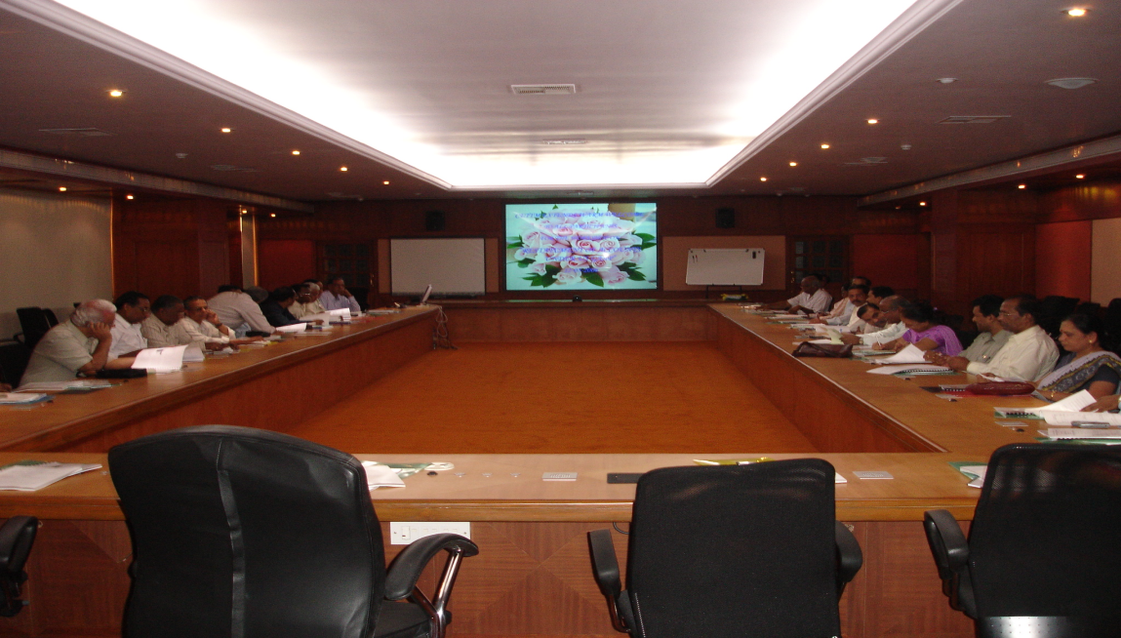
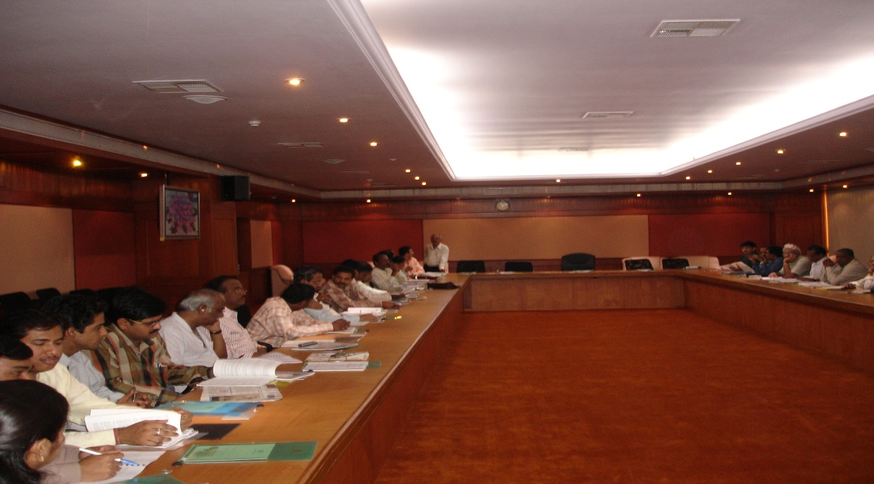
The Conference Hall
Ideal for Seminar, Conference, and Business meets

Slide 10
Telecom Technology Labs
BROADBAND
SDH & OF Systems
GSM
MPLS
FTTH
OCB 283
OFC CABLE
EWSD

Slide 11
Infrastructure Leasing
Computer Lab
6 fully networked Computer labs, 2 ADSL Broadband lab
Network lab equipped with CISCO Switches & CISCO Integrated Services Routers
Option for Broadband/Leased line internet connectivity
suitable for all kind of IT training
A computer lab equipped with Cisco Routers exclusive for networking courses
Suitable for all kinds of IT training

Slide 12
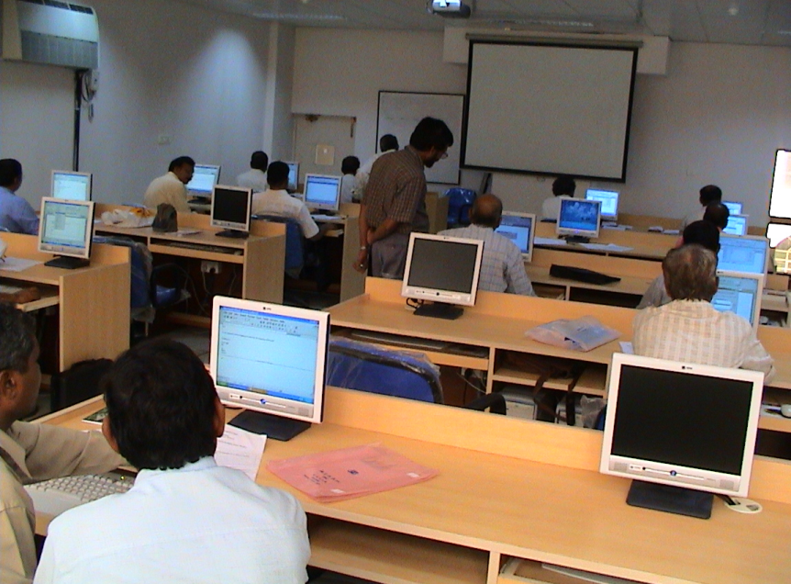
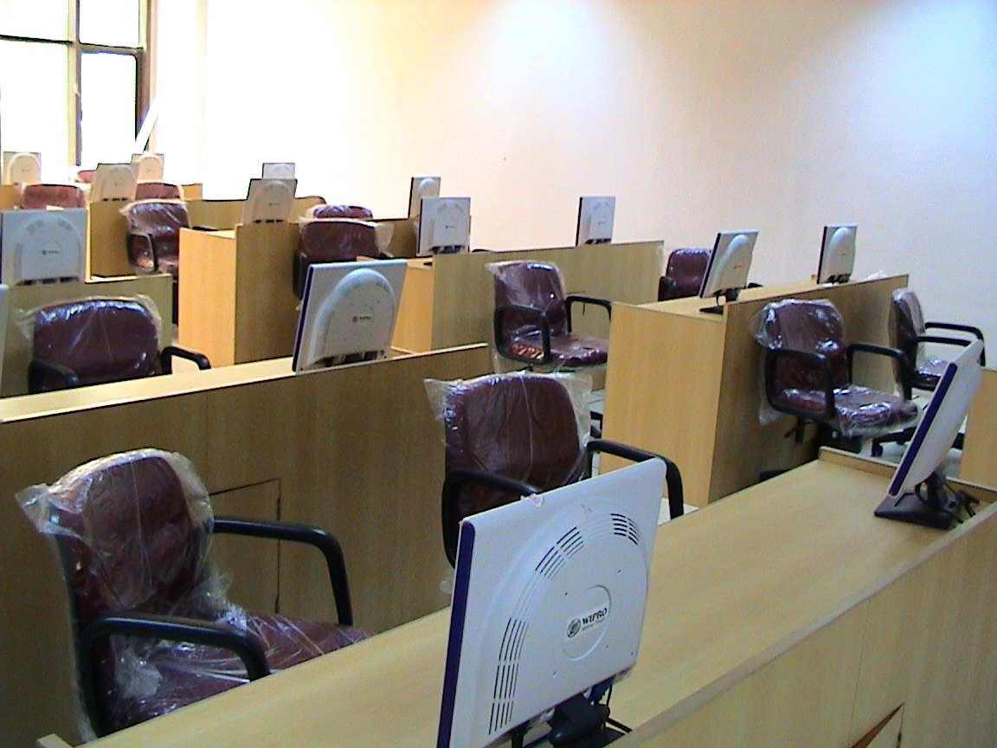
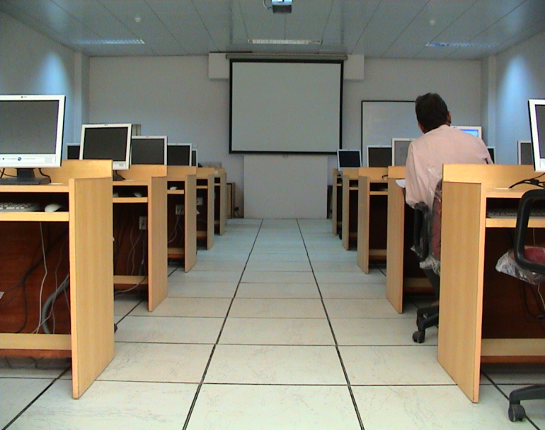
Computer Labs

Slide 13
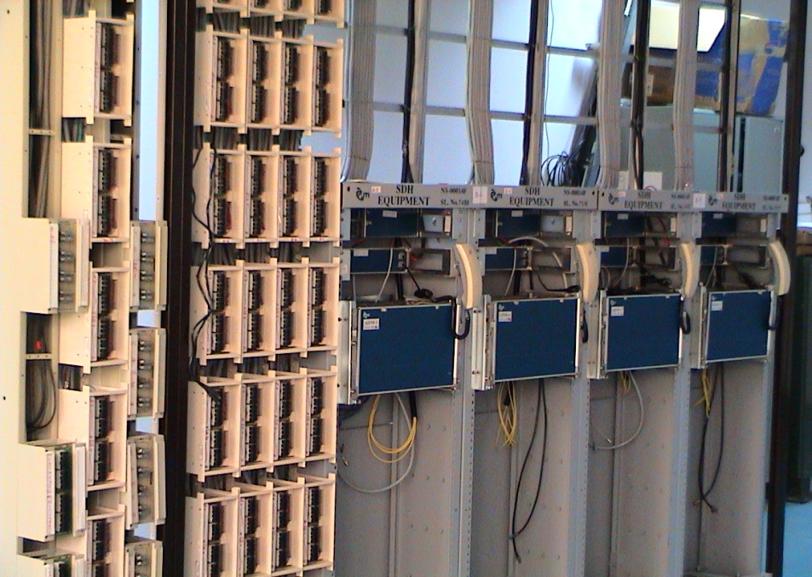
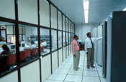
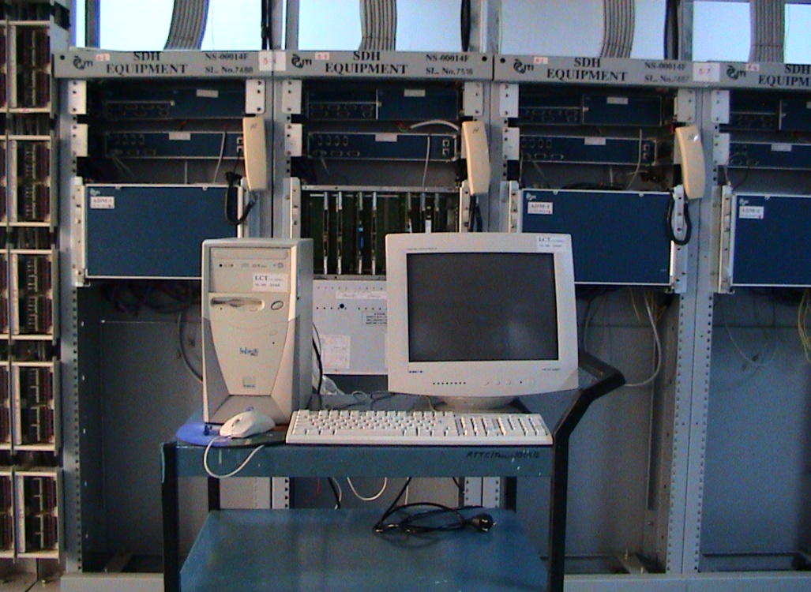
Telecom
Labs

Slide 14
OCB-283 Digital Switching LAB

Slide 15
OFC LAB

Slide 16
Transmission Lab

Slide 17
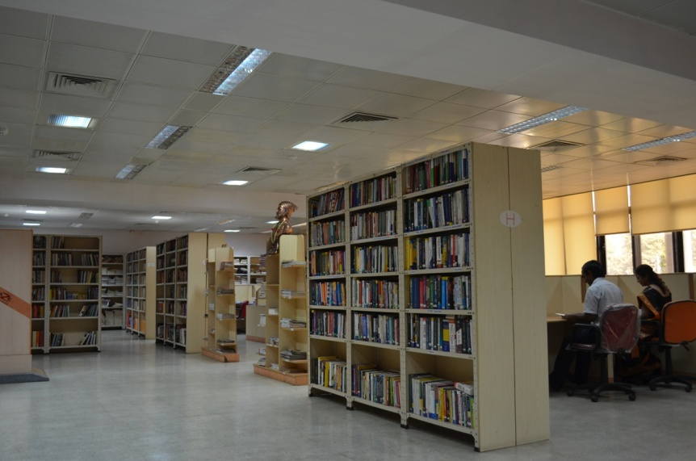
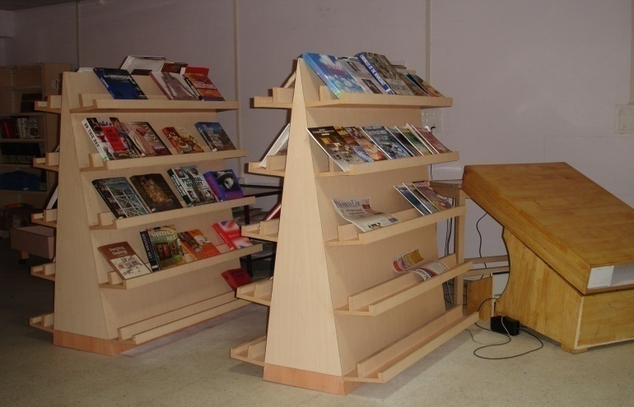
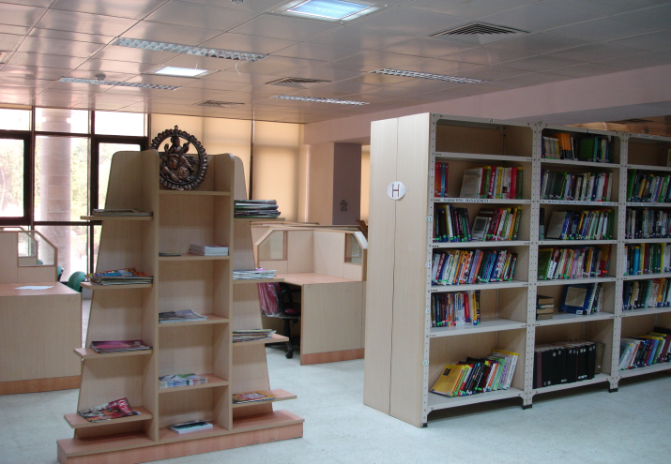
The Library
Fully Automated RFID Library
Approx 8500 books ranging from Technical & Management to General reading

Slide 18
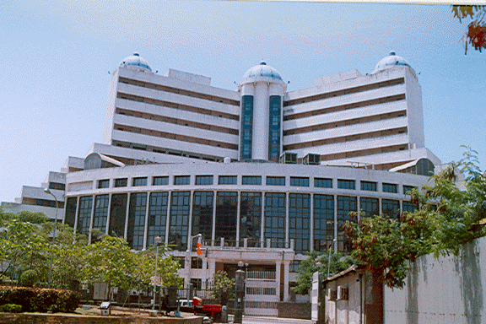
Hostel Facility

Slide 19
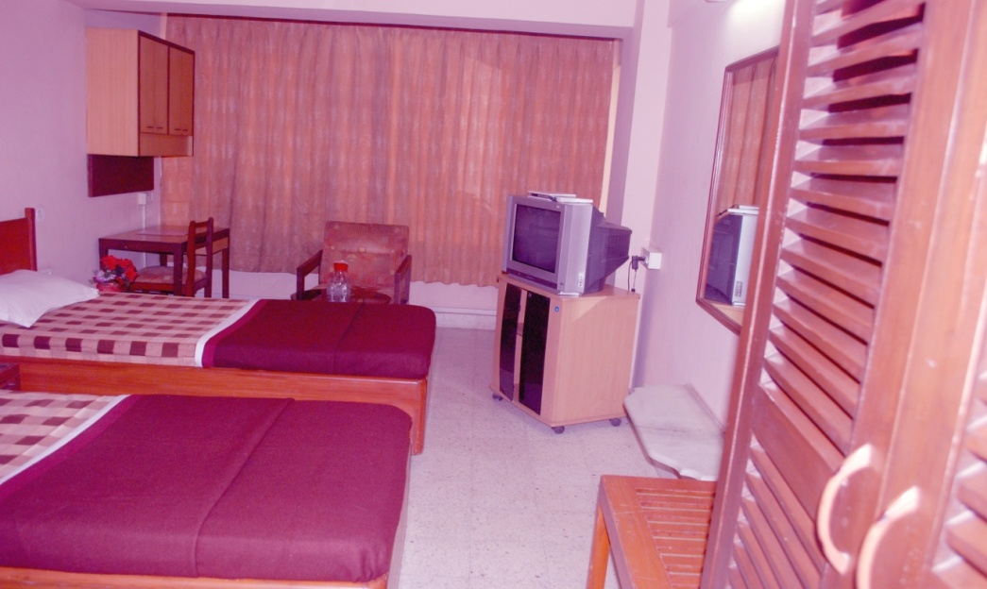
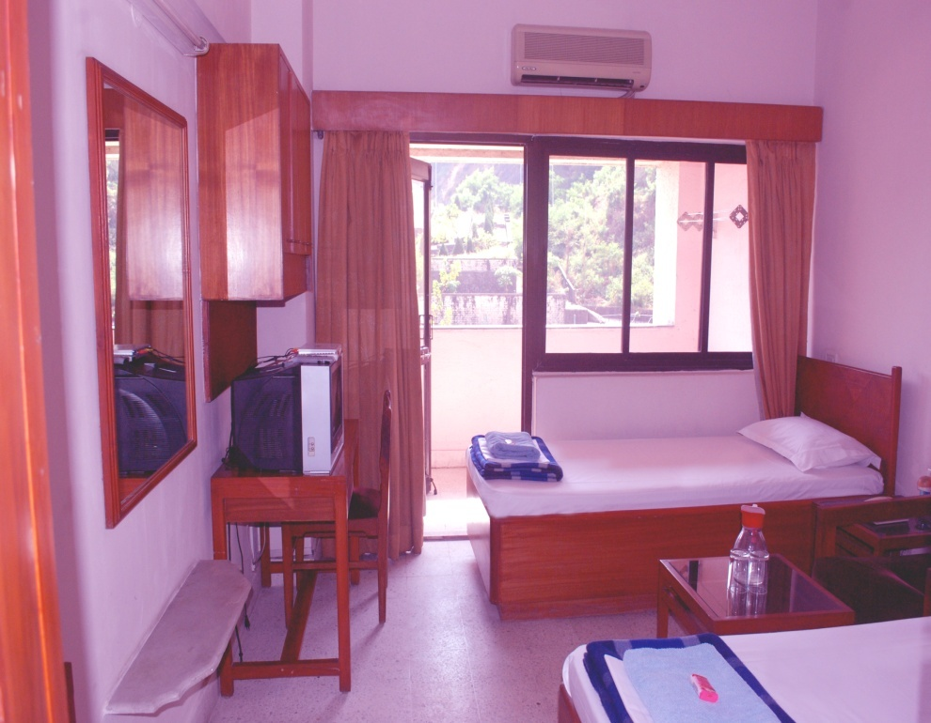
Hostel Room
Dual
Occupancy
414 No.s
(299 furnished)

Slide 20
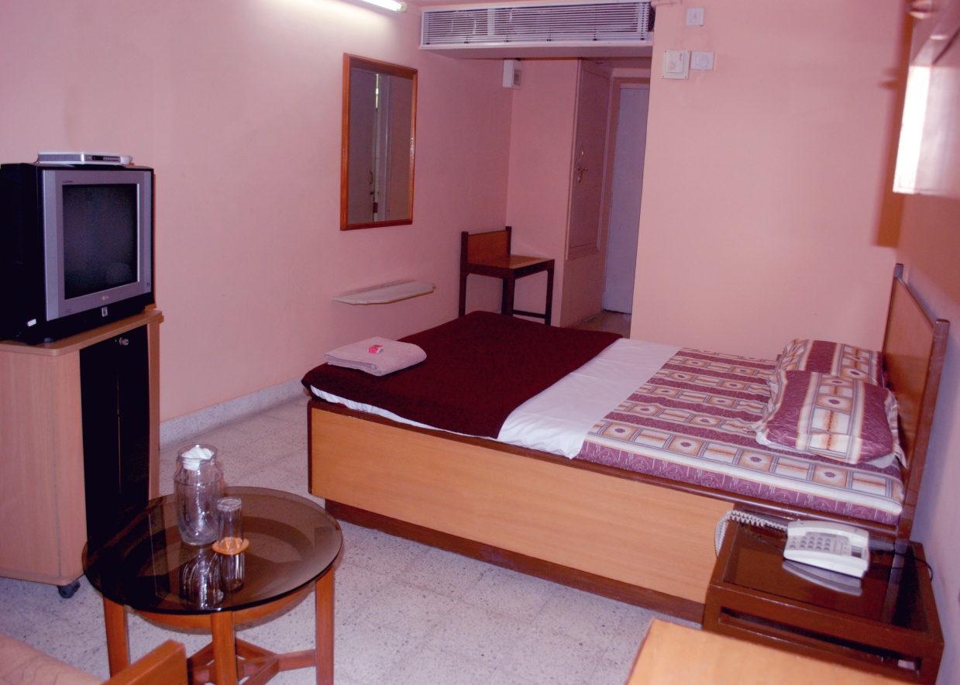
Hostel Room
Single
Occupancy
21 Nos.

Slide 21
1-Week course for Engg Students
1. Converged Communication
2. Optical Fiber Cable and Systems
3. 3G UMTS Network
4. Data Communication
5. IP MPLS & ADSL Technology
6. MySQL Database
7. PHP Programming
8. UNIX
9. RedHAT (RHCSA & RHCE)
(Vacation batches conducted during June & Dec)

Slide 22
Projects for Engg Students
1. GSM & 3G
2. MPLS Technology and Services
3. Broadband Technology and Services
4. Optical Fiber Cable and Systems
5. Digital Switching and NGN
6. Information Technology

Slide 23
Our Corporate Clients
NTPC
Power Grid Corp
Railtel
TCIL
Railways
Intelligence Agencies
SBI
Maharastra Elect Board
Mazgaon Dock
AAI
Tech Mahindra
Vodafone
L&T
Balaji Inst of Mgmt
ATOS
Welingkar Inst
Terna Engg. College
Tata Telecom
Min. of ICT Afganistan

Slide 24
Our Corporate Clients
CETTM
No of Countries participated in Trg = 96
No. of trainees trained = 1063
No. of Engg. Students trained under CSR = 1934
Students trained Ind. Internship Programme = 241
ITTM
No. of. of Engg. Students trained under CSR =772
Students trained Ind. trg = 1905

Slide 25
Contact us
Sr Manager (BD & PR)
5th Floor, CETTM
Technology Street,
Hiranandani Gardens,
Powai, Mumbai – 400076
Phone : 022- 2571 4900 / 2571 4580
Email ID: infra.cettm@mtnl.net.in
www.cettm.mtnl.in

